Slide 1

CAPSTONE PROJECT PRESENTATION VitaCore Pharmaceuticals: Sales Performance Analysis and Business Recommendations
Turning data into actionable business insights
Presented by: Stella Sirleaf
Tools Used: Microsoft Excel • Power Query • Power BI • DAX
Course: Business Data Analytics Capstone Project
Date: June 2026

Slide 2
Project Overview Objective: Analyze VitaCore sales performance and identify actionable business insights. Dataset Includes: Sales transactions, products, channels, ratings, returns, and location data. Tools Used: Excel, Power Query, Power BI, DAX. Key Performance Indicators: Revenue, profit, orders, units sold, returns, return rate, and average rating. Data Analytics Process
Raw Data
Power Query
Power BI Dashboard
Business Insights
Recommendations

Slide 3
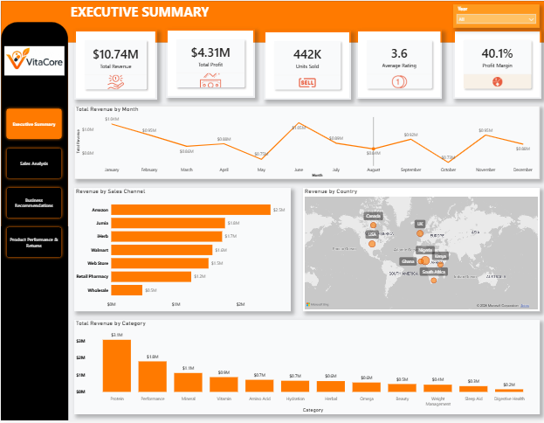





Executive Summary
Total revenue exceeded $10.7M, demonstrating strong sales performance.
The company generated over $4.3M in profit, indicating healthy profitability.
More than 442K units were sold across all products.
The overall return rate remained low at 2.3%, suggesting effective product quality.
Profit margin reached 40.1%, reflecting strong operational efficiency.

Slide 4
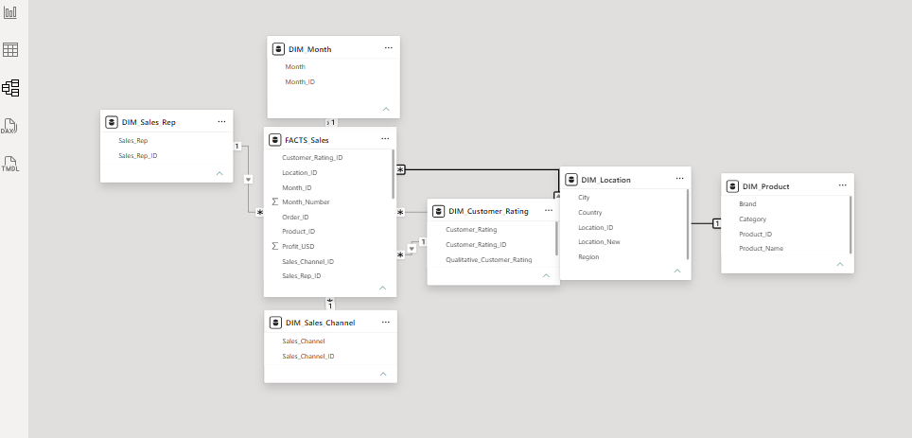
Data Model (Star Schema)
Central Fact Sales table stores transaction data.
Dimension tables (Product, Location, Month, Sales Channel, Sales Representative, Customer Rating) provide descriptive attributes.
The star schema improves performance, simplifies analysis, and supports accurate DAX calculations.

Slide 5
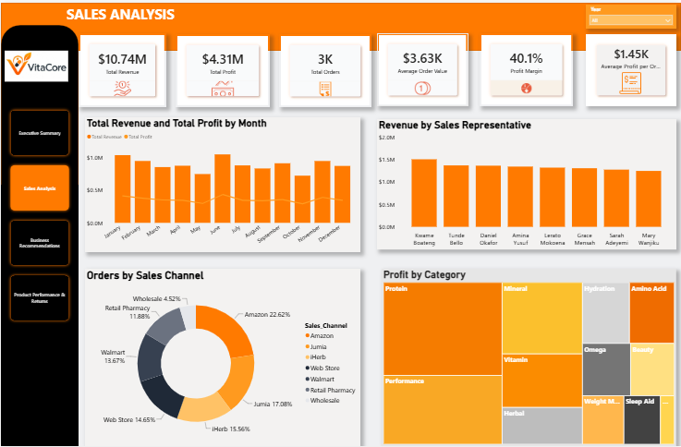




Sales Analysis
Monthly revenue remained relatively stable, with noticeable peaks during mid-year.
Sales representatives delivered fairly consistent revenue, indicating balanced performance across the team
Amazon and Retail generated the largest share of orders, making them the strongest sales channels.
Protein and Performance products contributed the highest profit among all product categories.
The dashboard highlights sales trends, channel performance, and product profitability to support business decisions

Slide 6
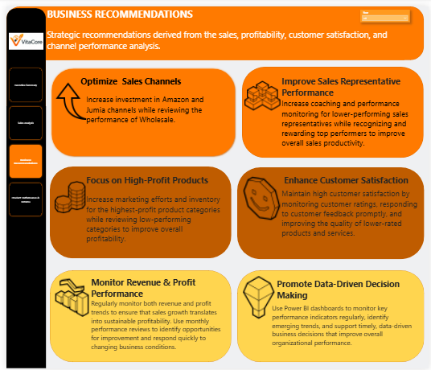

Slide 7
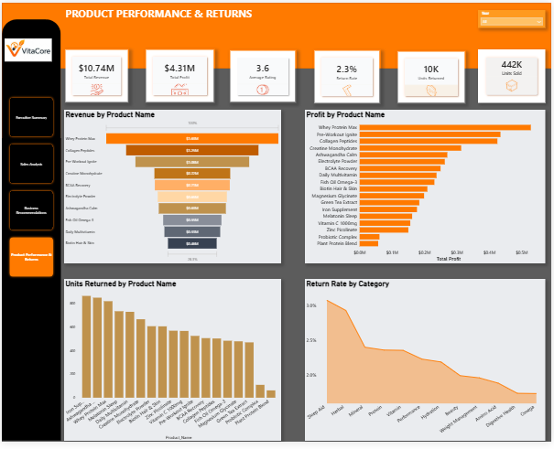
Product Performance & Returns
Whey Protein Max generated the highest profit, making it the top-performing product
Protein and Performance categories contributed the greatest overall profitability.
Several products recorded low unit returns, indicating strong product acceptance.
Return rates varied across product categories, highlighting areas for quality monitoring and improvement.
The dashboard provides valuable insights into product profitability and return trends, supporting inventory planning and product strategy.

Slide 8
Conclusion
This project demonstrated how Power BI can transform raw sales data into meaningful business insights. By analyzing revenue, profit, sales performance, customer behavior, and product returns, key opportunities for growth and operational improvement were identified.
The dashboards provide decision-makers with a clear, interactive view of business performance, enabling data-driven strategies that support profitability, customer satisfaction, and continuous business improvement.
Thank You

